Slide 1
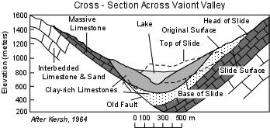
Historical Impact
This landslide enhanced our understanding of how changes in the groundwater system can cause landslides [4]
Figure 2

Slide 2
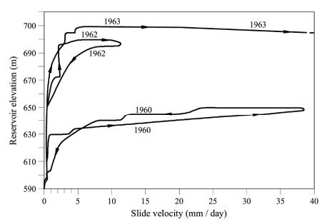
Historical Impact (cont.)
As the reservoir filled, the fluid pressure in the pore spaces and fractures of the clay-rich cretaceous limestone increased. [4,5]
As the water pressure increased, the south side of t the mountain began creep. [5]
What started as a slow creep gradually ramped up until it failed.* [5]
Figure 2
*Actually, it ramped up, and then abruptly stopped in 1960. It started picking up steam again in 1962, and as the reservoir levels reached 700 meters, the creep quickly picked up steam until it failed in a landslide.

Slide 3
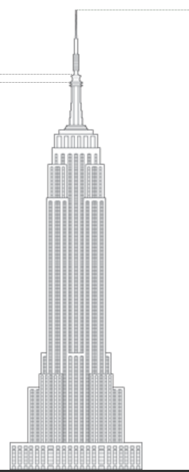
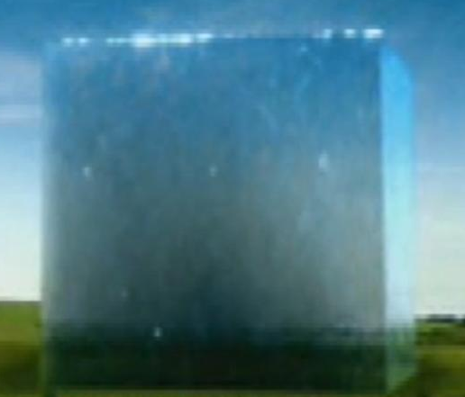
Interesting Facts
The landslide formed a wave consisting of 50 million meters³ of water. [1]
The wave was over 100 meters high after passing over the dam. [4]
As a perfect cube, it would be roughly 368 meters tall. That’s just 13 meters shy of reaching the top of the Empire State Building. [3]
368 Meters
Figure 3

Slide 4
Sources
[1] Expecting Disaster: The 1963 Landslide of the Vajont Dam, Arcadia, 2011, no. 8. http://www.environmentandsociety.org/arcadia/expecting-disaster-1963-landslide-vajont-dam
[2] Vaiont Dam Disaster(FDSCI201)10-28-14 - https://app.box.com/embed/preview/v1mr79c7nne4aqss6x78pozg3ud3ru5o?theme=dark
[3] Empire State Building, The Global Tall Building Database of the CTBUH, http://skyscrapercenter.com/building/empire-state-building/261
[4] Nelson, S. Slope Stability, Triggering Events, Mass Movement Hazards, http://www.tulane.edu/~sanelson/Natural_Disasters/slopestability.htm
[5] E.E. Alonso et al., Geomechanics of Failures. Advanced Topics : Chapter 2 - Catastrophic Slide: Vaiont Landslide, Italy , DOI 10.1007/978-90-481-3538-7_2, © Springer Science+Business Media B.V. 2010 http://www.springer.com/cda/content/document/cda_downloaddocument/9789048135370-c2.pdf?SGWID=0-0-45-1117450-p173923428
Figure 1: http://www.tulane.edu/~sanelson/Natural_Disasters/slopestability.htm
Figure 2: page 45 http://www.springer.com/cda/content/document/cda_downloaddocument/9789048135370-c2.pdf?SGWID=0-0-45-1117450-p173923428
Figure 3: Composite: http://www.realflowforum.com/attachments/imported/41091/water%20cube%20effect%202.jpg - http://skyscrapercenter.com/building/empire-state-building/261

